Slide 1
VOLARE PROJECT
Tutor and Learners in Co-teaching
Workshop

Slide 2
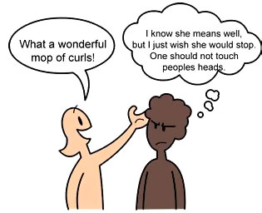
The content of this workshop refers to...
misunderstandings in the European cultural environment

Slide 3
Participants Actors
Tutors/Teachers & Learners/Students
1 Tutor/Teacher – moderator
3 Learners/ Students – co-teachers

Slide 4
Main Objectives
To identify different situations which can bring misunderstandings in a multicultural environment
To achieve knowledge about the culture of 3 European countries ( different than the ones of participants )

Slide 5
Strategies / Methods
Self – research
Role - play
Debates
Presentations about self-research concerning European culture
Feedback

Slide 6
Duration
For the co-teachers ‘ self-research and power-point presentations - 2 hours
For the workshop activities – 50 minutes

Slide 7
Materials Resources
Computer
Video-projector
Worksheets
Whiteboard / flipchart
Markers
Internet
Books

Slide 8
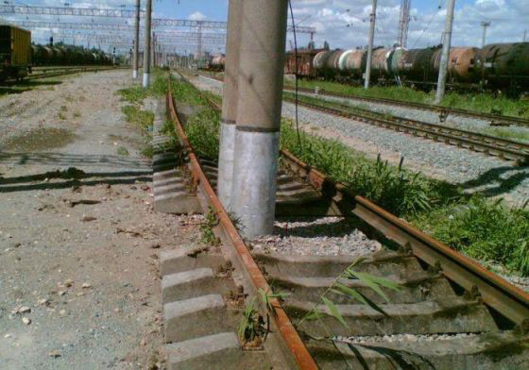
Workshop ‘s Activities:
1. Warm-up ( Moderator )
The moderator starts with a joke about people from different
countries, taking care of not bringing offence to a nation .
e.g. Can you guess where was this picture taken ?
2. Reflection ( Moderator )
What do you think about the following statement :
When you are in Rome do as Romans do !

Slide 9
Workshop’s Activities
3. Role – playing ( Participants)
The three co-teachers split the participants into small groups and give worksheets with tasks about factual situations which can bring to cultural misunderstandings.
e.g. : A visit to a family from a different culture
A business meeting with a person from another country
A traditional wedding of friends from another country

Slide 10
Workshop’s Activities
4. Group debates
Participants will share their opinion about the factual situations
they have been presented by co-teachers .
5. Presentations
Co-teachers will make presentations about traditions and
culture of the chosen countries which they had researched
before the workshop.
6. Conclusions: DOs and DON’Ts
Participants moderated by co-teachers will make a list of Dos
and DON’Ts in those three countries.

Slide 11
Evaluation of the activity
Participants will fill in a worksheet with :
1. What they had known about these countries before attending this course
2. What they’ve learned in this course
3. What more they would like to know about the multicultural environment
I’d known that … | I’ve learned that… | I would like to find out about …

Slide 12
Observations
The frame of this workshop can be adjusted to various topics and it wants to prove that co-teaching make students to be involvement in all the three stages of a learning activity ( planning, implementation and evaluation ).
Students/learners may change their role of co-teachers for the following classes / workshops .

Slide 13
Thank you for your attention and good luck in your teaching and learning activities !
Made by VOLARE Romanian Team

